Slide 1
Project Title
Sales Performance Analysis of Walmart Stores Using Advanced MySQL Techniques
Final SQL Project Submission
BY
GAJRAJ THUKRAN (16-07-2025)

Slide 2
Introduction:
Walmart, a major retail chain, operates across several cities, offering a wide range of products. The dataset provided contains detailed transaction data, including customer demographics, product lines, sales figures, and payment methods.
Tools used:
MYSQL, Excel(for visuals)
Objective:
Analyze sales data using SQL

Slide 3
Dataset Overview:

Slide 4
Task 1:
Identifying the Top Branch by Sales Growth Rate
Objective:
Walmart wants to identify which branch has exhibited the highest sales growth over time
SQL Query:
alter table walmartsales1 add column new_date date;
alter table walmartsales1 drop column date;
update walmartsales1 SET new_date = STR_TO_DATE(Date, '%d-%m-%Y’);
SELECT Branch, MONTH(new_date) AS Sale_Month,
sum(quantity) as total_sales,
round(SUM(Total),2) AS Monthly_Sales_revenue
FROM walmartsales1
GROUP BY Branch, month(new_date)
ORDER BY Branch, Sale_Month;
This query calculates monthly sales and revenue per branch

Slide 5
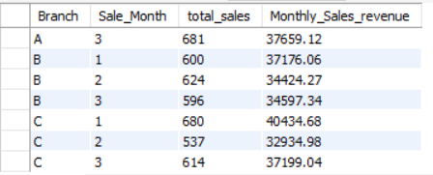
Output Table
In the output table we only calculate monthly sales and revenue per branch to compare growth rate we use excel charts

Slide 6
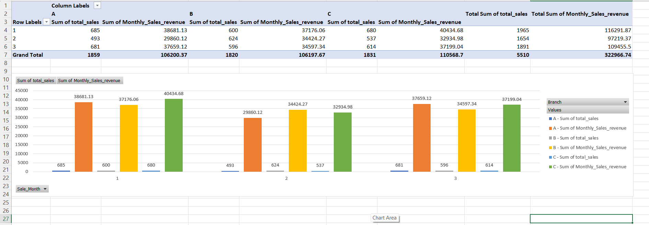
Visuals:
So to compare growth rate across months here are three visuals to show it better first a bar chart followed by two line charts one showing total sales and one for total revenue

Slide 7
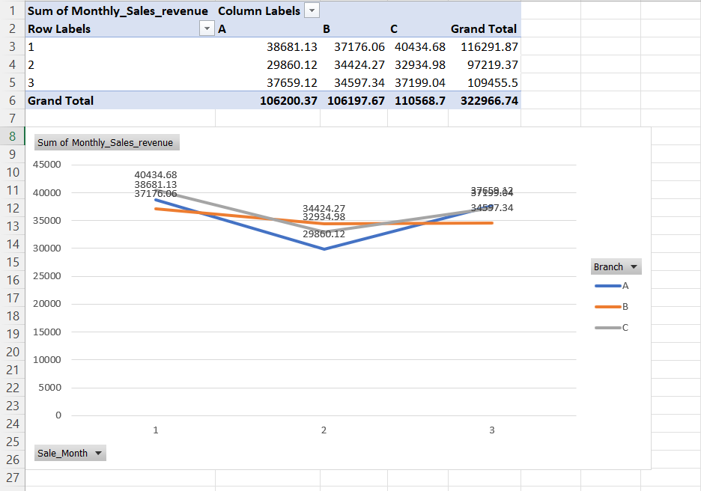
Revenue Comparison:

Slide 8
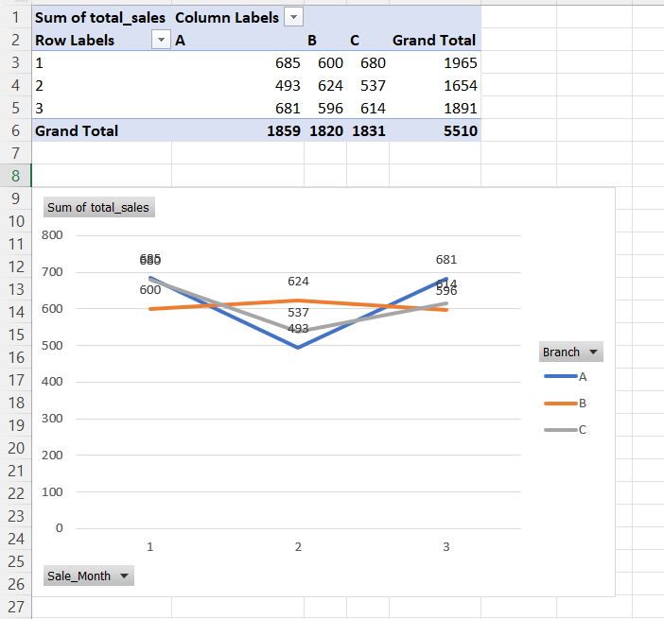
Sales Comparison:

Slide 9
Task 2:
Finding the Most Profitable Product Line for Each Branch
Objective:
Walmart needs to determine which product line contributes the highest profit to each branch
SQL Query:
select Branch, `Product line`,
round(sum(`gross income`),2) as total_profit
from walmartsales1
group by branch, `product line`
order by branch,total_profit desc;
This query will give us all product line per branch with their revenue

Slide 10
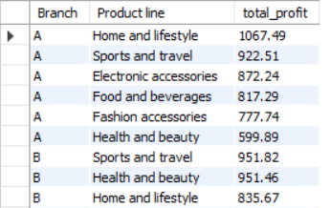
Output Table:

Slide 11
SQL Query to get only top product line per branch
with total_profit as (
select branch,`product line`,
round(sum(`gross income`),2) as revenue,
rank() over(partition by branch order by sum(`gross income`) desc) as rnk
from walmartsales1
group by branch,`product line`)
select * from total_profitwhere rnk =1;

Slide 12

Output Table:

Slide 13
Task 3:
Analyzing Customer Segmentation Based on Spending
Objective:
Walmart wants to segment customers based on their average spending behavior as high, low, medium spenders
SQL Query:
select `customer id`,round(avg(total),2) as avg_total,
case
when avg(Total)<300 then "low“
when avg(Total) between 300 and 700 then "medium“
else "high“
end as spending
from walmartsales1
group by `customer id`;
This query will give us customers behaviour as high,low and medium spenders

Slide 14
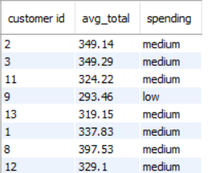
Output Table:

Slide 15
Task 4:
Detecting Anomalies in Sales Transactions
Objective:
Walmart suspects that some transactions have unusually high or low sales compared to the average for the product line
SQL Query:
create temporary table avg_data as (
select `product line`, round(avg(total),2) as avg_sales
from walmartsales1
group by `product line`);
select * from avg_data;
with anomalies as (
select w.`product line`,w.`invoice id`,w.branch,w.gender,w.`customer id`, w.total,
Case when w.total > avg_data.avg_sales*1.7 then 'high anomaly’
when w.total < avg_data.avg_sales*.4 then 'low anomaly’
else 'normal’
end as anomaly
from walmartsales1 w
Join
avg_data on w.`product line` = avg_data.`product line`) select * from anomalies;

Slide 16
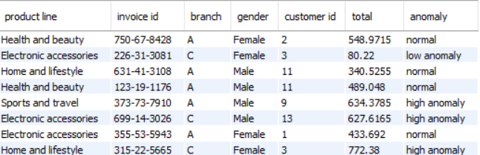
Output Table:

Slide 17
Task 5:
Most Popular Payment Method by City
Objective:
Walmart needs to determine the most popular payment method in each city to tailor marketing strategies
SQL Query:
select city,payment,count(payment) as payment_method
from walmartsales1
group by city,payment
order by city,payment_method desc;
This query will give us all type of payment method across city

Slide 18
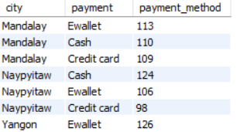
Output Table:

Slide 19
SQL Query to see only top payment method across city:
with payment_method as (
select city,payment,count(*) as payment_type,
rank() over( partition by city order by count(*) desc) as rnk
from walmartsales1
group by city,payment)
select * from payment_method
where rnk=1;

Slide 20
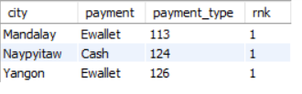
Output Table:

Slide 21
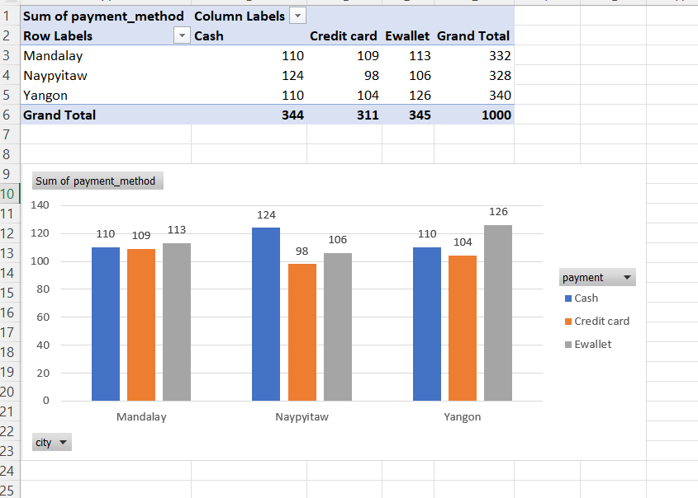
Visual representation:

Slide 22
Task 6:
Monthly Sales Distribution by Gender
Objective:
Walmart wants to understand the sales distribution between male and female customers on a monthly basis
SQL Query:
select gender,month(new_date) as months,
sum(quantity) as total_sales,
round(sum(total),2) as total_revenue
from walmartsales1
group by gender,months
order by months,gender;
This query will give us sales and revenue distribution between genders across various months

Slide 23
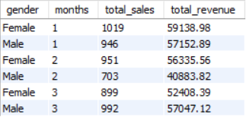
Output Table:

Slide 24
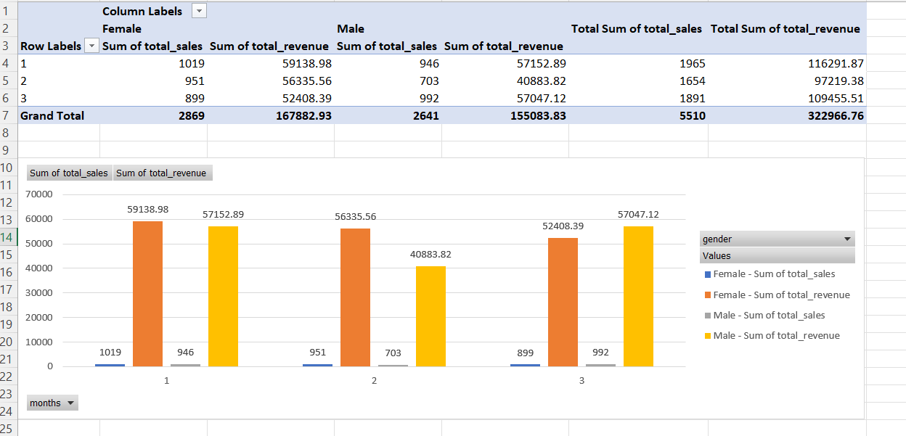
Visual Representation:

Slide 25
Task 7:
Best Product Line by Customer Type
Objective:
Walmart wants to know which product lines are preferred by different customer types
SQL Query:
select customertype,`product line`,
count(`product line`)
from walmartsales1
group by customertype,`product line`;
This query will give us different product line across customertype

Slide 26
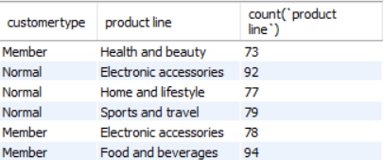
Output Table:

Slide 27
SQL Query to get only top product line for customertype:
with customer as (
select customertype,`product line`,
count(*) as product_count,
row_number() over(partition by customertype order by count(*) desc) as rnk
from walmartsales1
group by customertype,`product line`)
select * from customer
where rnk=1;

Slide 28

Output Table:

Slide 29
Task 8:
Identifying Repeat Customers
Objective:
Walmart needs to identify customers who made repeat purchases within a specific time frame e.g., within 30 days
SQL Query:
with repeat_cust as (
select w.`customer id` as purchase_1,
b.`customer id` as purchase_2,
w.new_date as purchase_date_1,
b.new_date as purchase_date_2,
datediff(b.new_date,w.new_date) as days_difference
from walmartsales1 w
Join
walmartsales1 b
on w.`customer id`=b.`customer id`
where b.new_date > w.new_date)
select * from repeat_cust where days_difference <=30;
This query will give us customers who make a repeat purchase within 30 days of first purchase

Slide 30
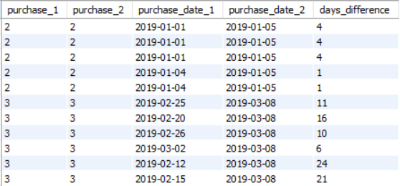
Output Table:

Slide 31
Task 9:
Finding Top 5 Customers by Sales Volume
Objective:
Walmart wants to reward its top 5 customers who have generated the most sales Revenue
SQL Query:
select `customer id`,
round(sum(total),2) as sales_revenue
from walmartsales1
group by`customer id`
order by sales_revenue desc limit 5;
This query will give us top 5 customers based on their purchases

Slide 32
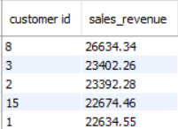
Output Table:

Slide 33
Task 10:
Analyzing Sales Trends by Day of the Week
Objective:
Walmart wants to analyze the sales patterns to determine which day of the week brings the highest sales
SQL Query:
SELECT DAYNAME(new_date) AS Day_Of_Week,
COUNT(*) AS No_Of_Transactions,
sum(quantity) as total_sales,
ROUND(AVG(Total), 2) AS Avg_Sale_Per_Transaction,
round(SUM(Total),2) AS Total_Sales_revenue
FROM walmartsales1
GROUP BY Day_Of_Week
ORDER BY Total_Sales DESC;
This query will give us all data related to a single day whether it is total transactions, total sales, total revenue

Slide 34
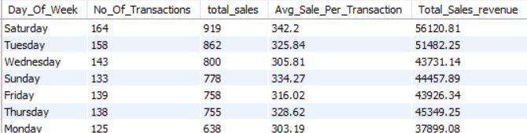
Output Table:

Slide 35
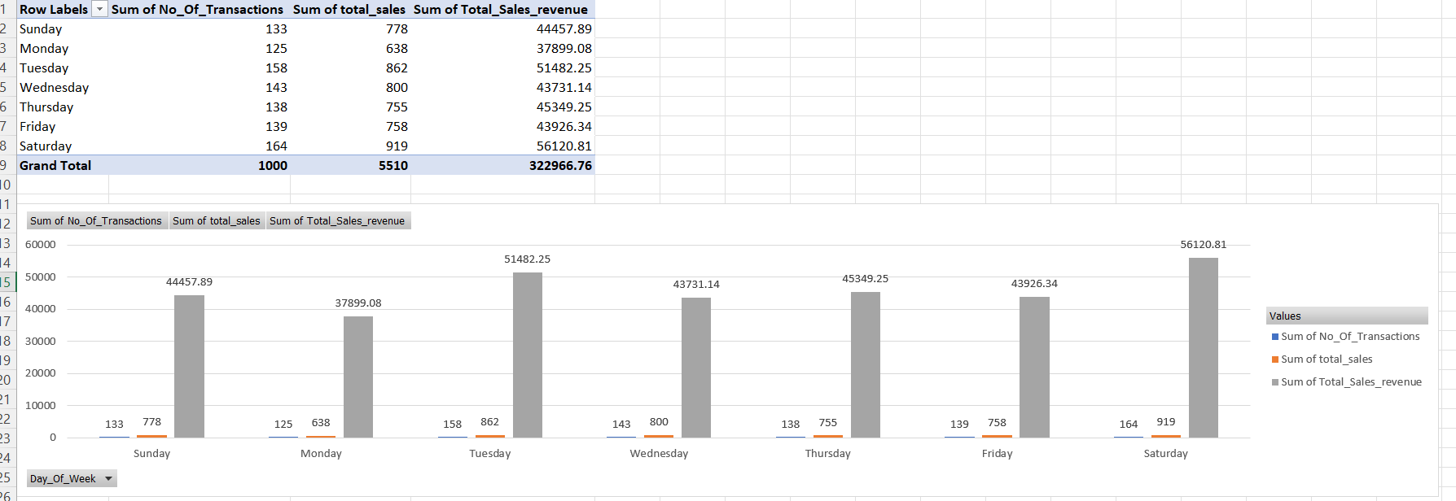
Visual Representation:

Slide 36
Challenges Faced:
Loading CSV file to MYSQL Workbench
Handling date and int columns

Slide 37
Learnings AND Conclusion:
Window functions
Joins, Temporary Table, many more SQL keywords
Data Preparation
Business insights:
From our findings we can say that Females generating more revenue comparing to Men’s,
Also weekends have generally more sales producing more revenue
Video Link:
Https://drive.google.com/file/d/1N7HXIPLjHsB0xNUYOqcHTbaKaeuN7-_5/view?usp=drivesdk

Slide 38
Thank You
Project By
GAJRAJ THUKRAN

